Slide 1
Nested Wilson Loop

Slide 2
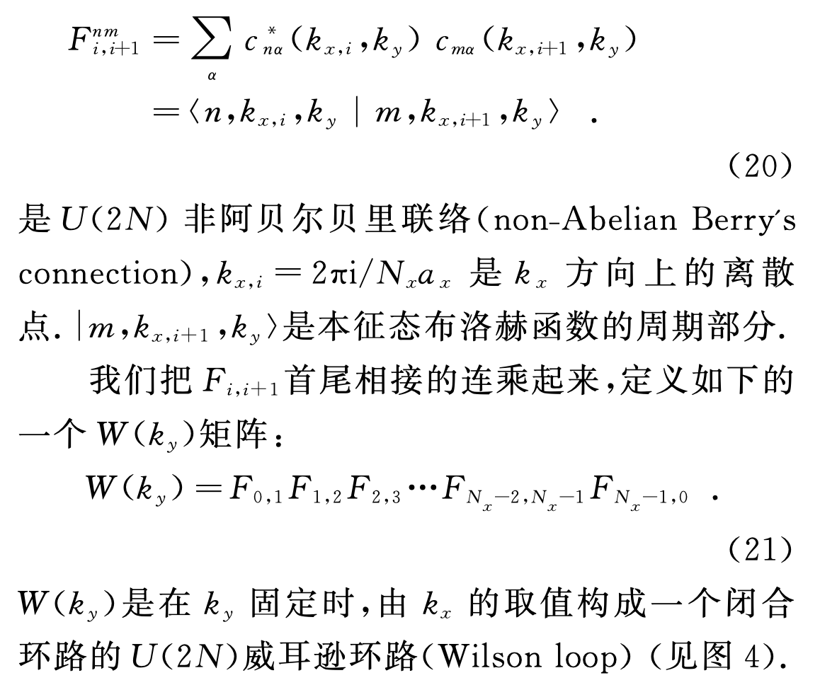
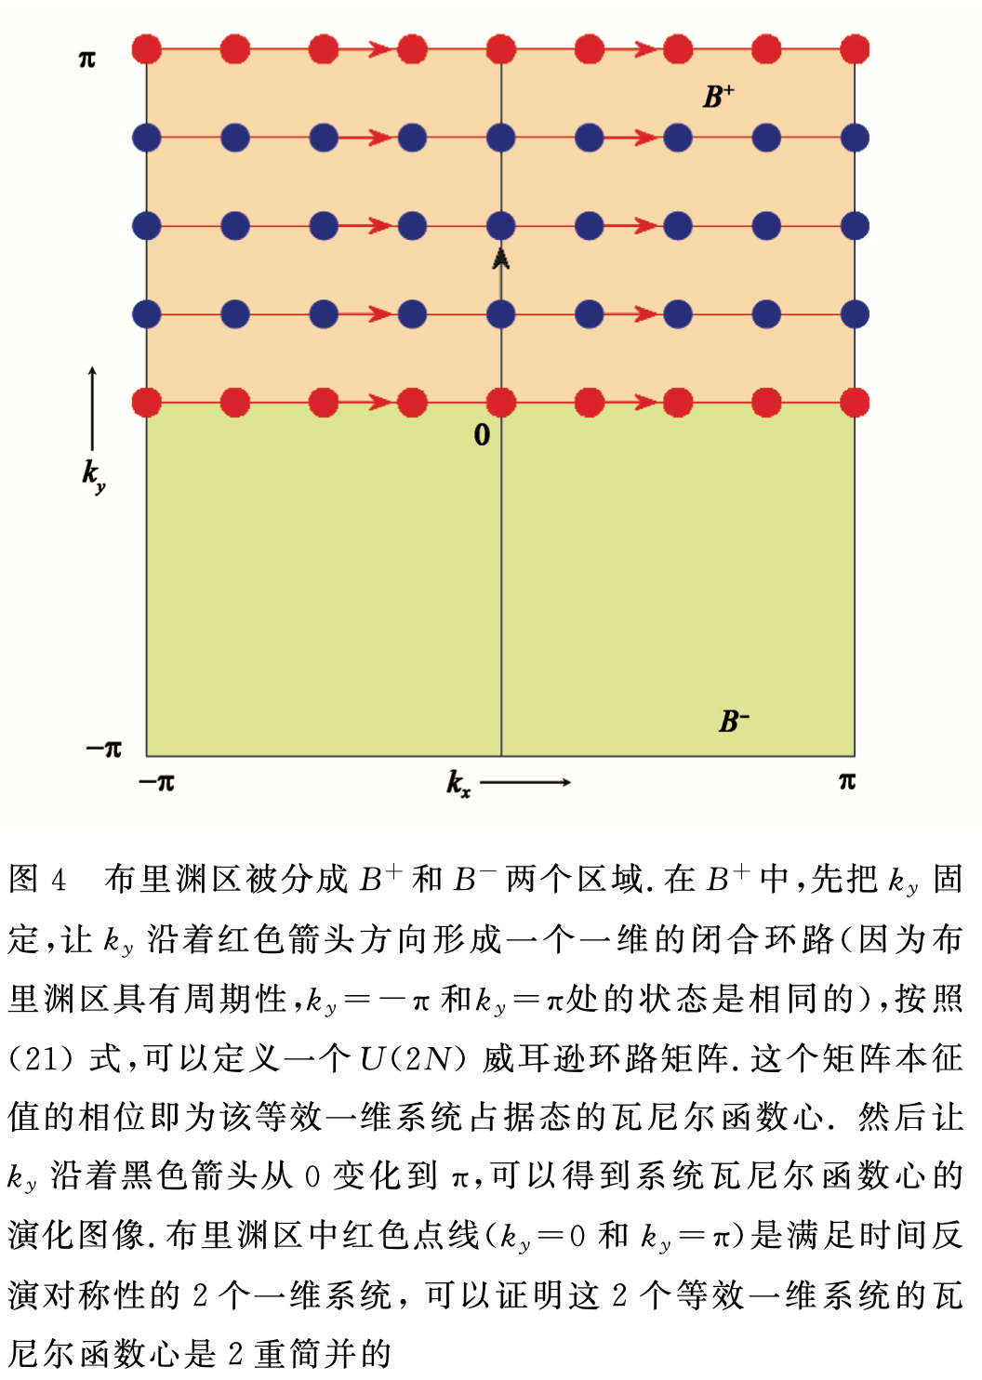
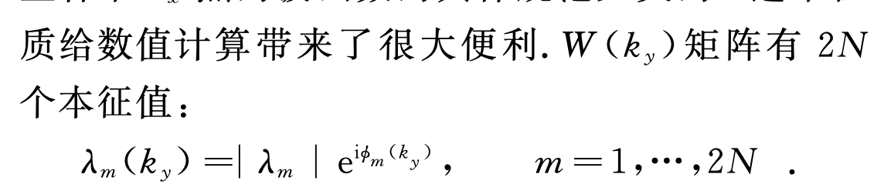
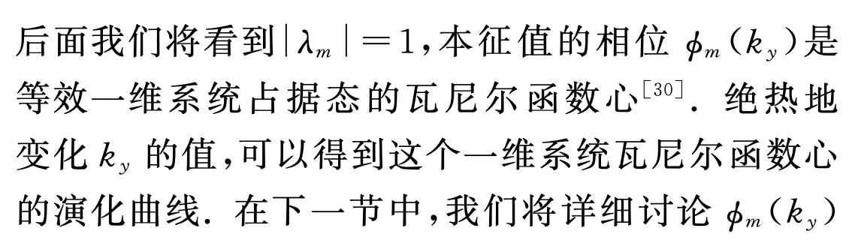
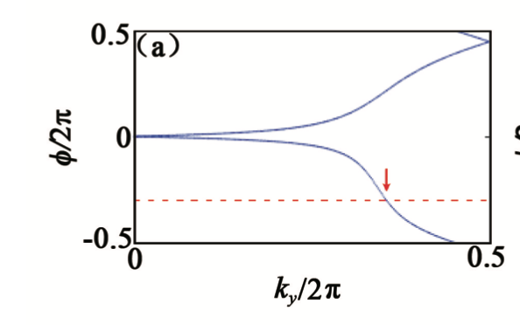
1 Wilson Loop
Rui Yu, Xiao Liang Qi, Andrei Bernevig, Zhong Fang, and Xi Dai. Phys. Rev. B 84, 075119
余 睿 方 忠 戴 希 Z2 拓扑不变量与拓扑绝缘体 http://www.wuli.ac.cn/CN/Y2011/V40/I07/462

Slide 3
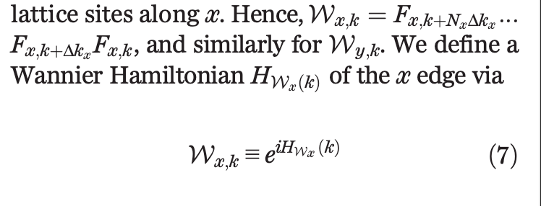
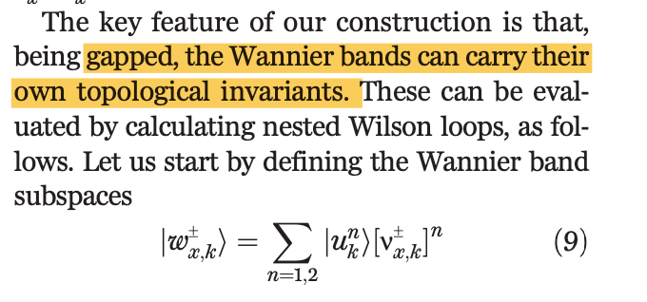
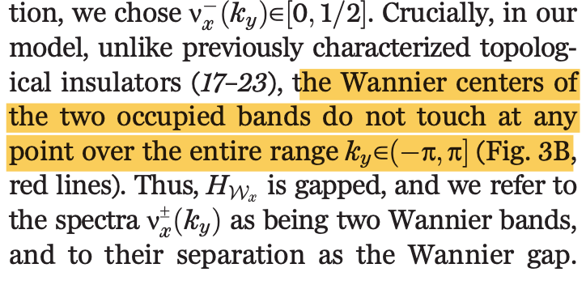
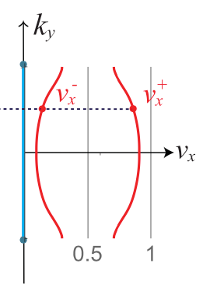
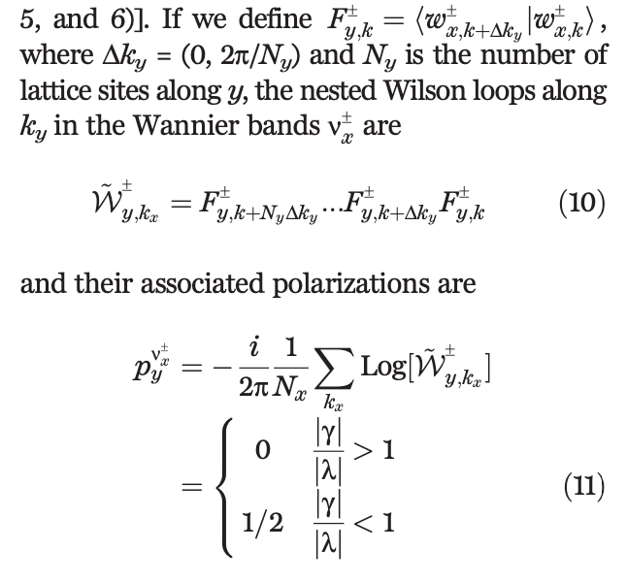
2 nested Wilson Loop
Benalcazar, Bernevig, Hughes, Science 357, 61–66 (2017)
10.1126/science.aah6442

Slide 4
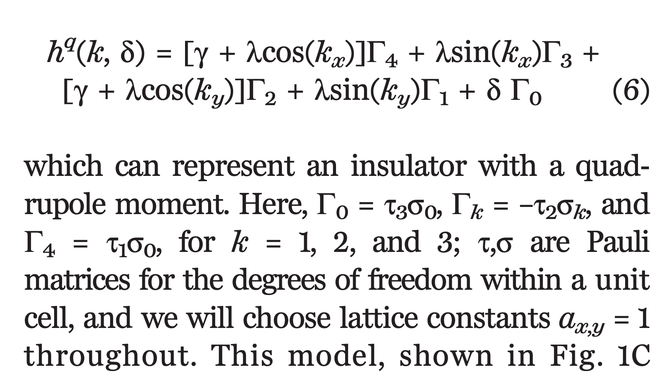
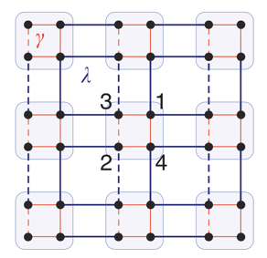
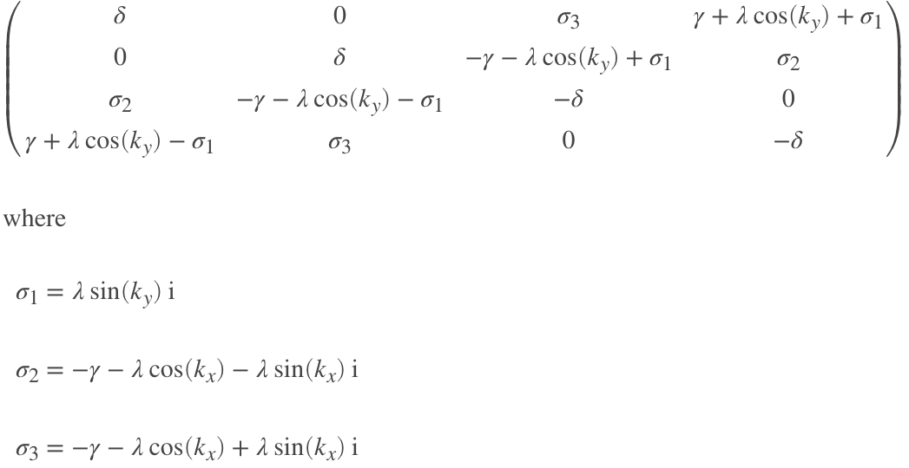
3.1 example - 2017 science
gamma = 0.8
lambda = 1
delta = 0
nested berry phase: 𝛑

Slide 5
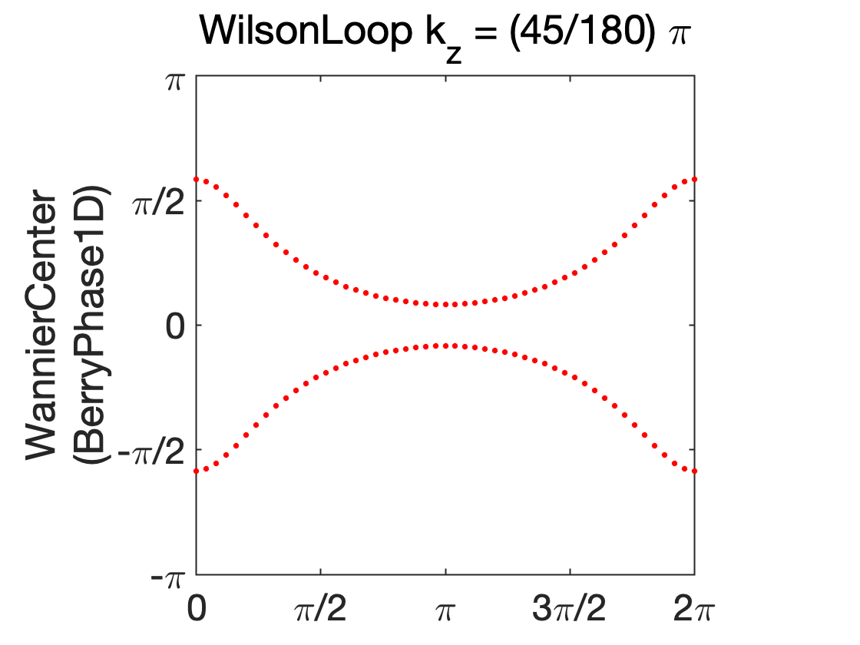
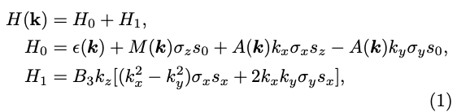
3.2 example – HODSM kp
DP
k_x
kp2TB(tetra) model in CuI

Slide 6
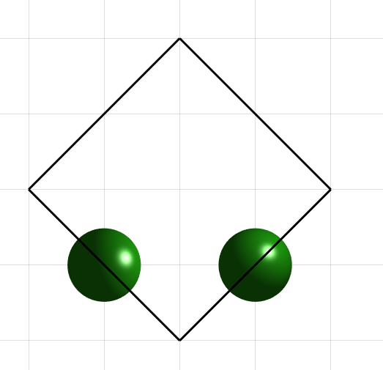
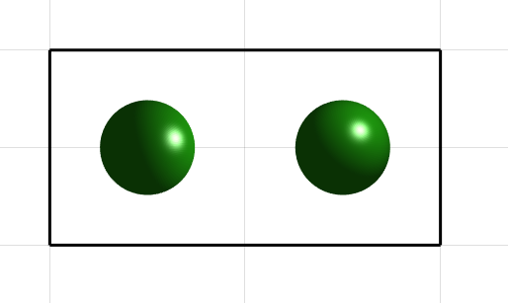
Supercell
kz = 0
kz = 0.1pi

Slide 7

3.3 example – HODSM kp hex
DP
k_x
kp2TB(hex) model in CuI

Slide 9
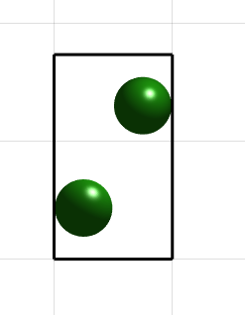
Supercell hex
kz = 0.1pi

Slide 10
DP

Slide 11
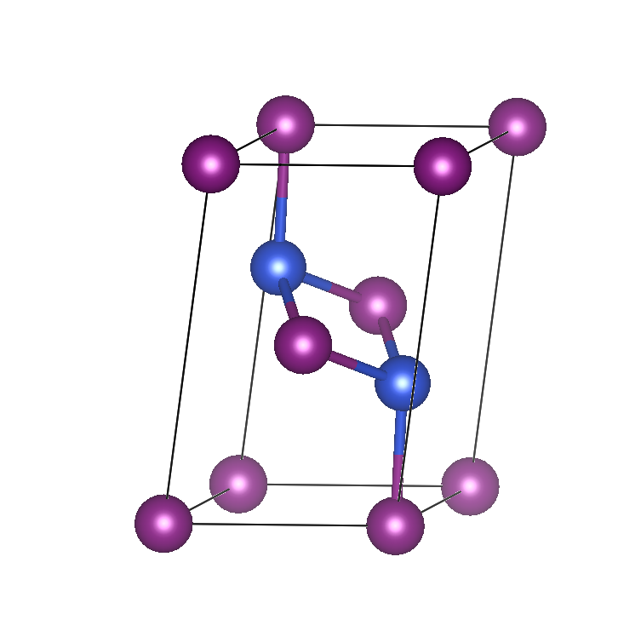
3.4 example – HODSM CuI wannier
8带
如果在 HR中加上各轨道位置信息
则 不会 有0对称

Slide 12
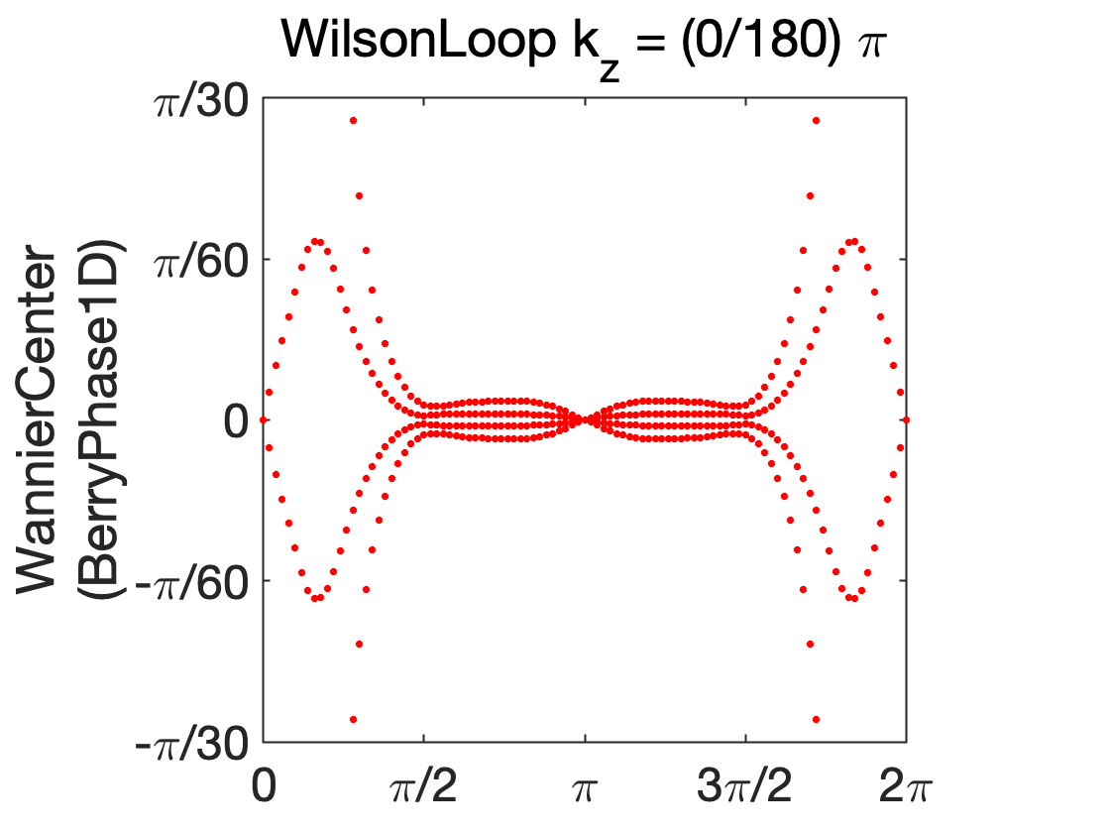
CuI wannier
如果不考虑 HR中加上各轨道位置信息
则 会 有0对称

Slide 13
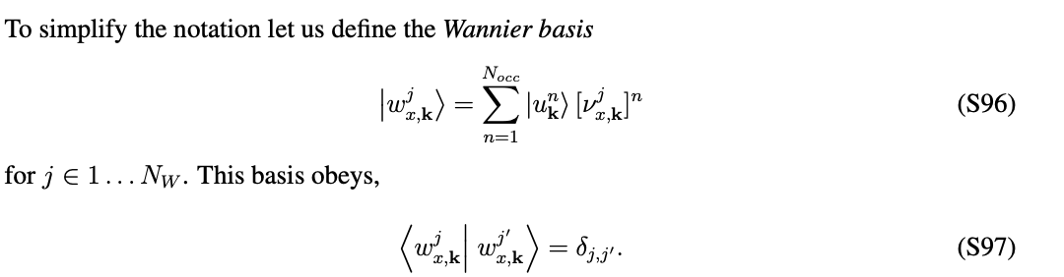
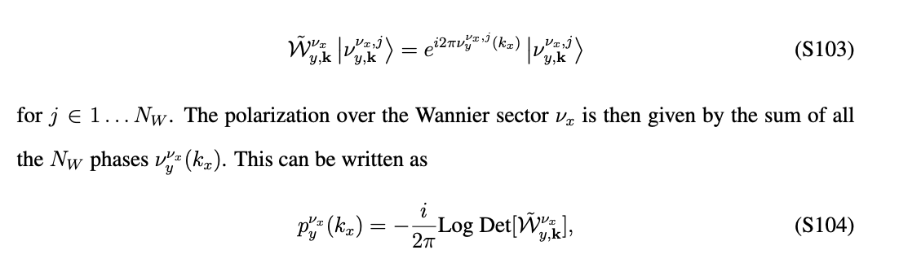
CuI wannier nested Berry phase Multi band

Slide 14
test
4 occupi

Slide 16
尝试投影
以DP附近的 WAVECAR为基准
Basis(1,:) = [1+1i,0,1+1i,0,0,0,0,0]/4;
Basis(2,:) = [0,1-1i,0,1-1i,0,0,0,0]/4;
Basis(3,:) = [0,0,0,0,1-1i,0,1+1i,0]/4;
Basis(4,:) = [0,0,0,0,0,1+1i,0,1-1i]/4;
CuI_P = CuI.project(conj(Basis));

Slide 17
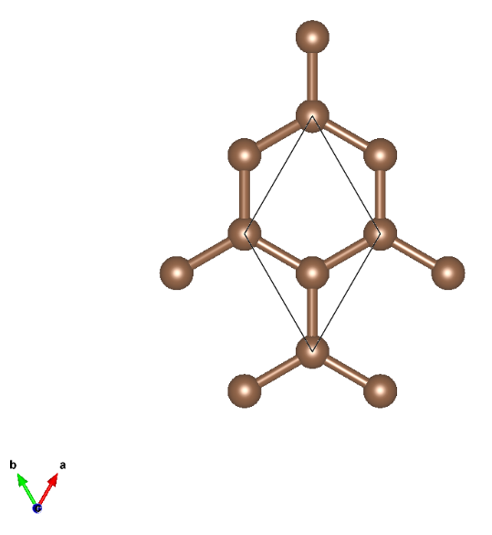
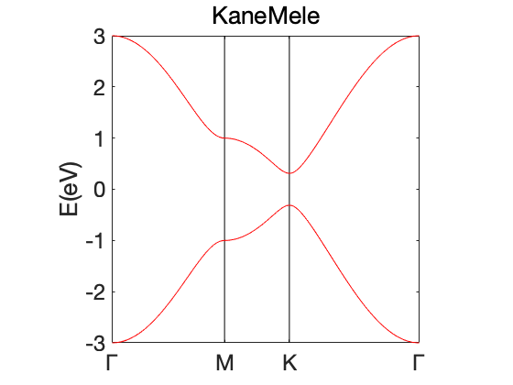
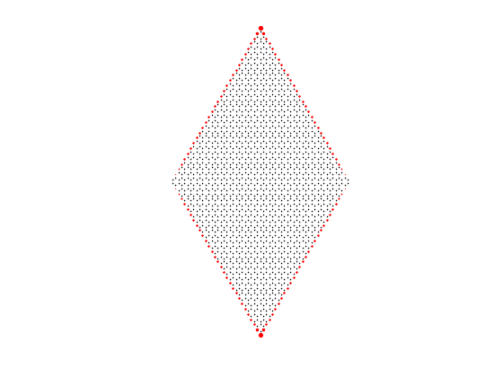
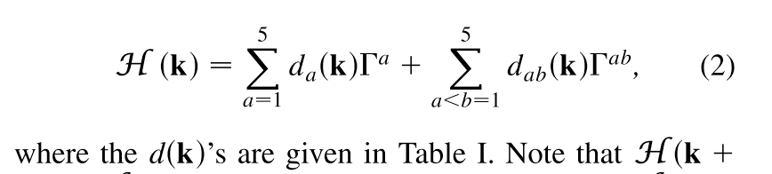
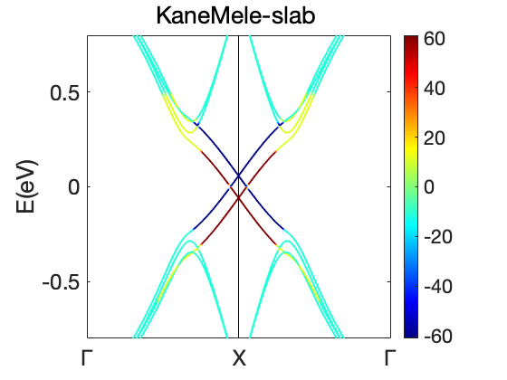
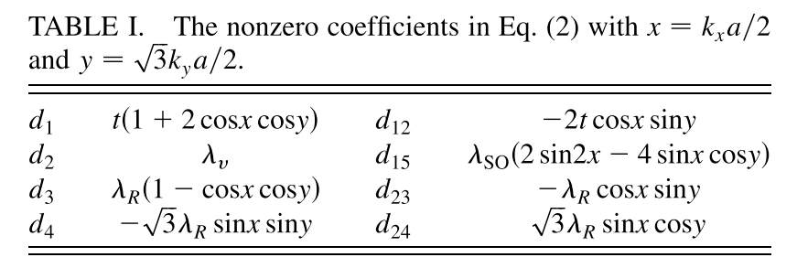
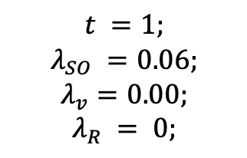
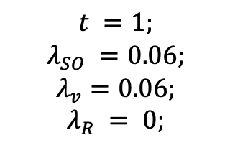
KaneMele
$$t =1;$$
$$λ_{SO} =0.06;$$
$$λ_{v}=0.00;$$
$$λ_{R} = 0;$$
$$t =1;$$
$$λ_{SO} =0.06;$$
$$λ_{v}=0.06;$$
$$λ_{R} = 0;$$

Slide 18
KaneMele Fmx
不能打开gap

